Slide 1
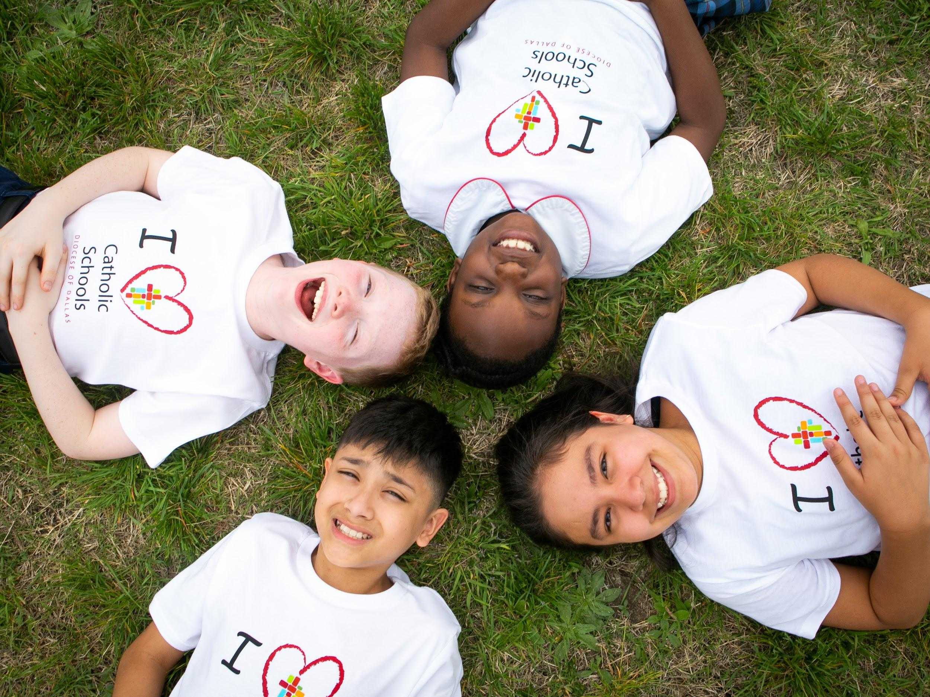
FIRST
IMPRESSIONS
MATTER.

Slide 2
WHY DO FIRST IMPRESSIONS MATTER?
Seven seconds or less to make a decision about someone you meet
Princeton Study- takes tenth of a second to form an impression of a stranger from their face, and that longer exposures don’t significantly alter those impressions
Digital age has trained our expectations
Generational shifts
Millennials increasingly sensitive to companies’ first impressions
Study from Healthcare Providers Network showed “millennials pay close attention to office appearance, cost, customer service and the quality of products used during a visit”

Slide 3
GOALS FOR TODAY
Identify the things your school & other schools do to make great first impressions
Develop a plan to make your school’s appearance match its mission
“Do not let perfect be the enemy of done.”

Slide 4
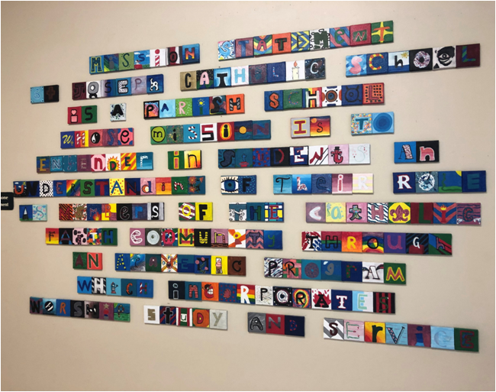
COMMUNICATING YOUR MISSION

Slide 5
THREE FIRST IMPRESSIONS:
Curb Appeal
Online Presence
Website
Reviews & Searches
Social Media
Inside the Building

Slide 6
CURB APPEAL
What does your building communicate to people who are driving past on the main road?
If you were seeing your school for the first time...
Would you know it was a school? Know its name? Know whether You could attend or how to learn more? Feel it was a safe place?

Slide 7
CURB APPEAL
Examining your building through another’s eyes
Not what you do see, but what you don’t see
Chipping paint
Weeds
Burned out light bulbs
Trash or dead plants
Broken windows
Welcoming signs direct visitors to:
Correct parking lot
Visitor parking spots
Main Entrance
Front Office

Slide 8
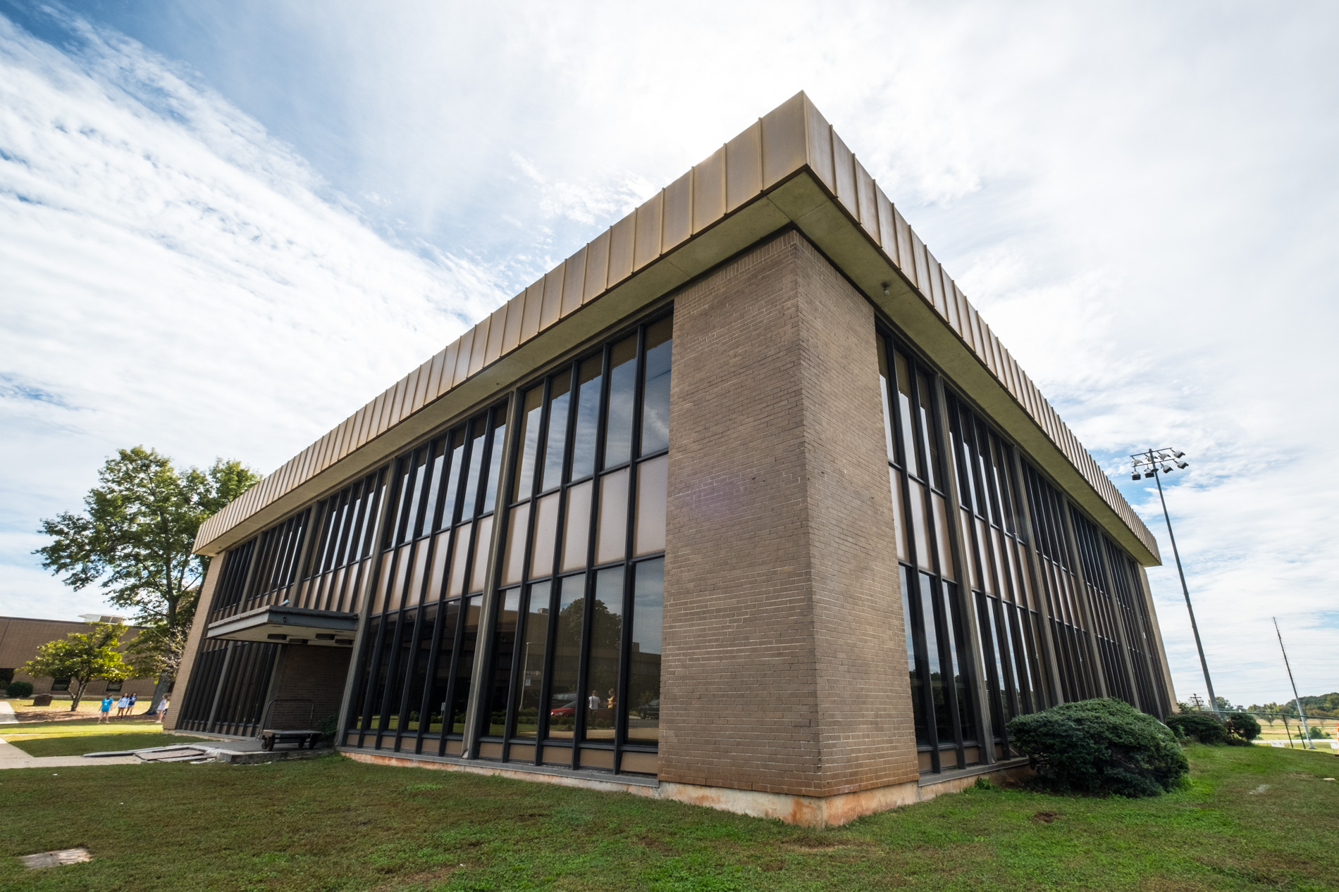
CURB APPEAL
School name is visible
Flower beds well maintained
Outer walls power-washed as needed
Building is secure
Signs direct visitors to the front office

Slide 9
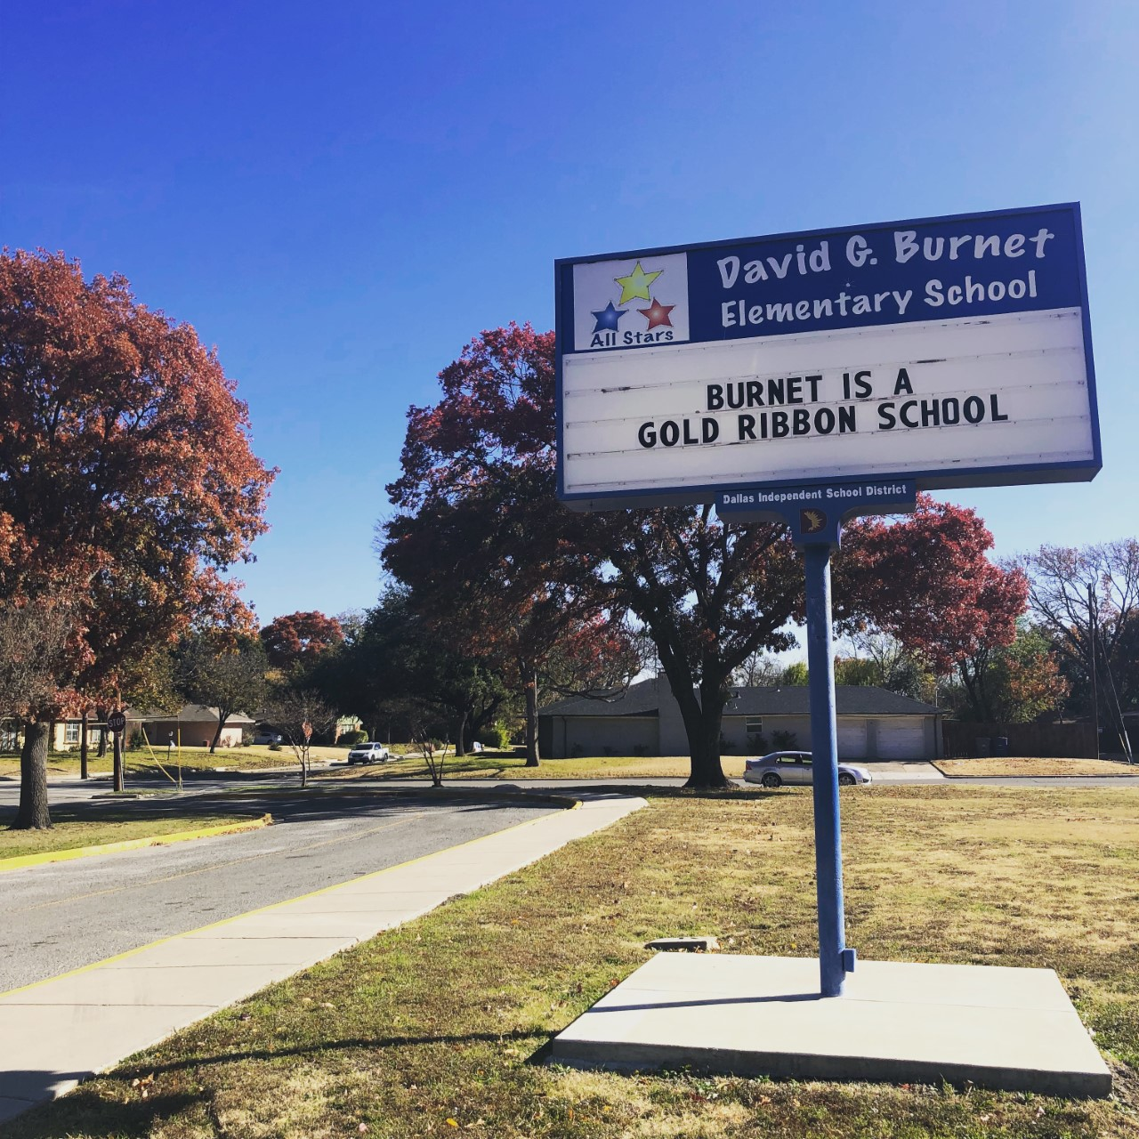
CURB APPEAL
Display accomplishments
Ensure message board works & is updated

Slide 10
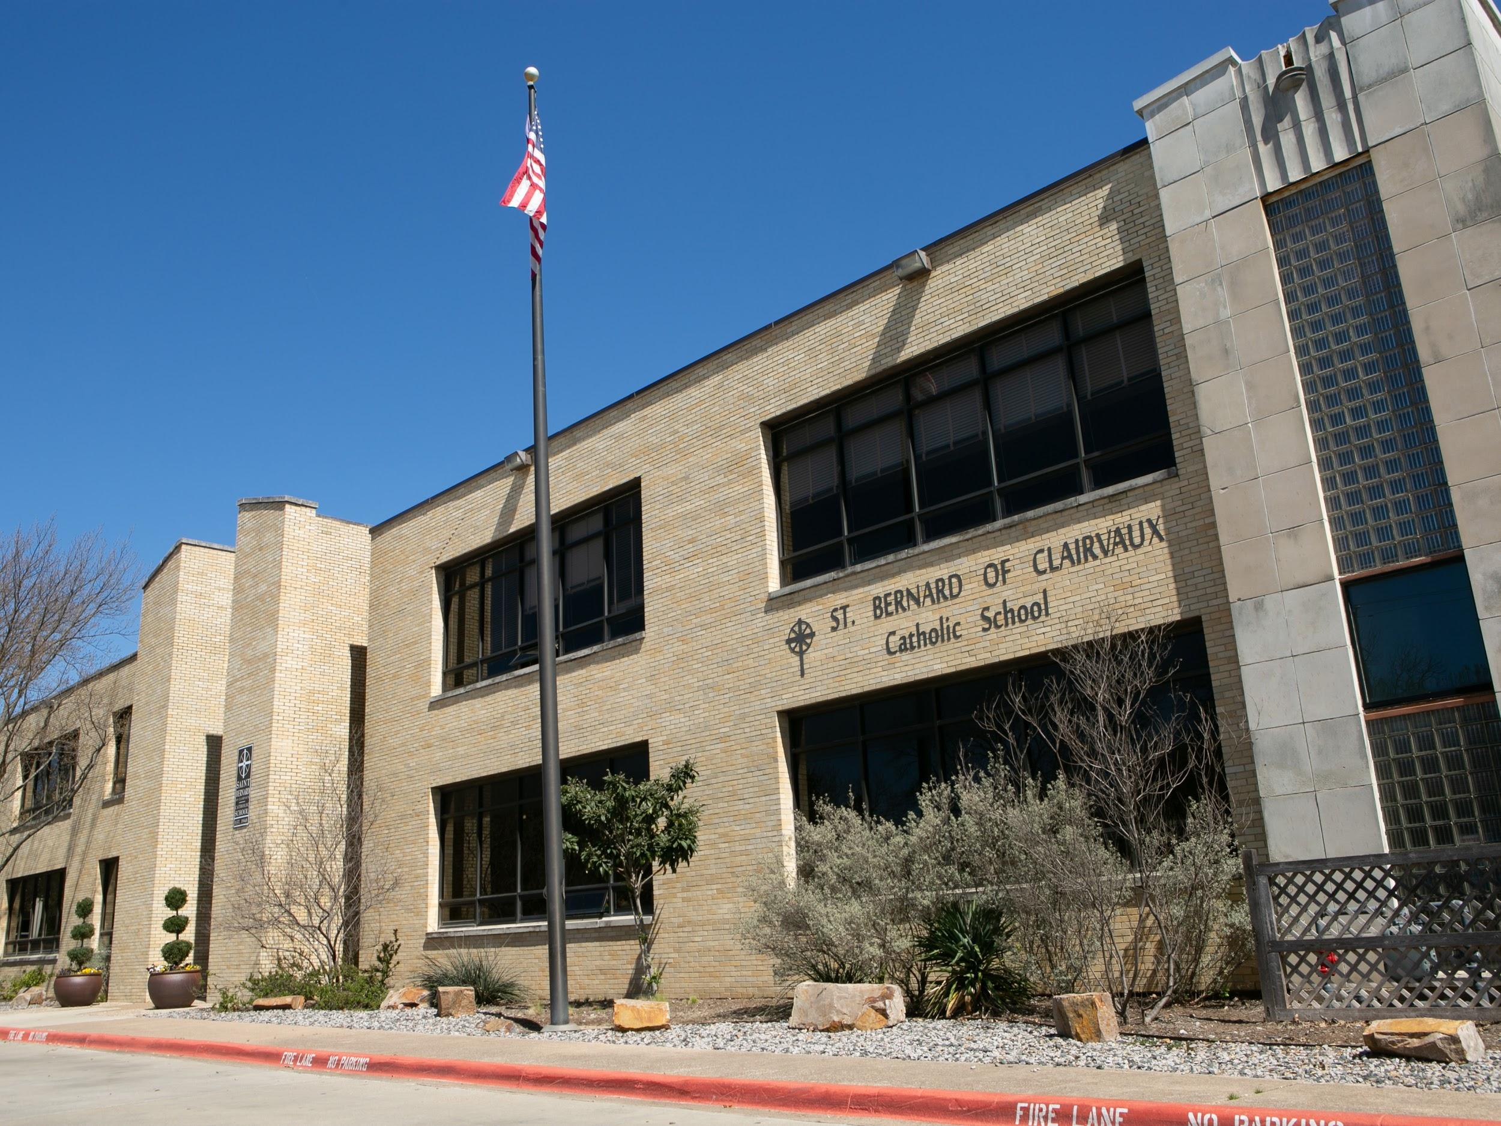
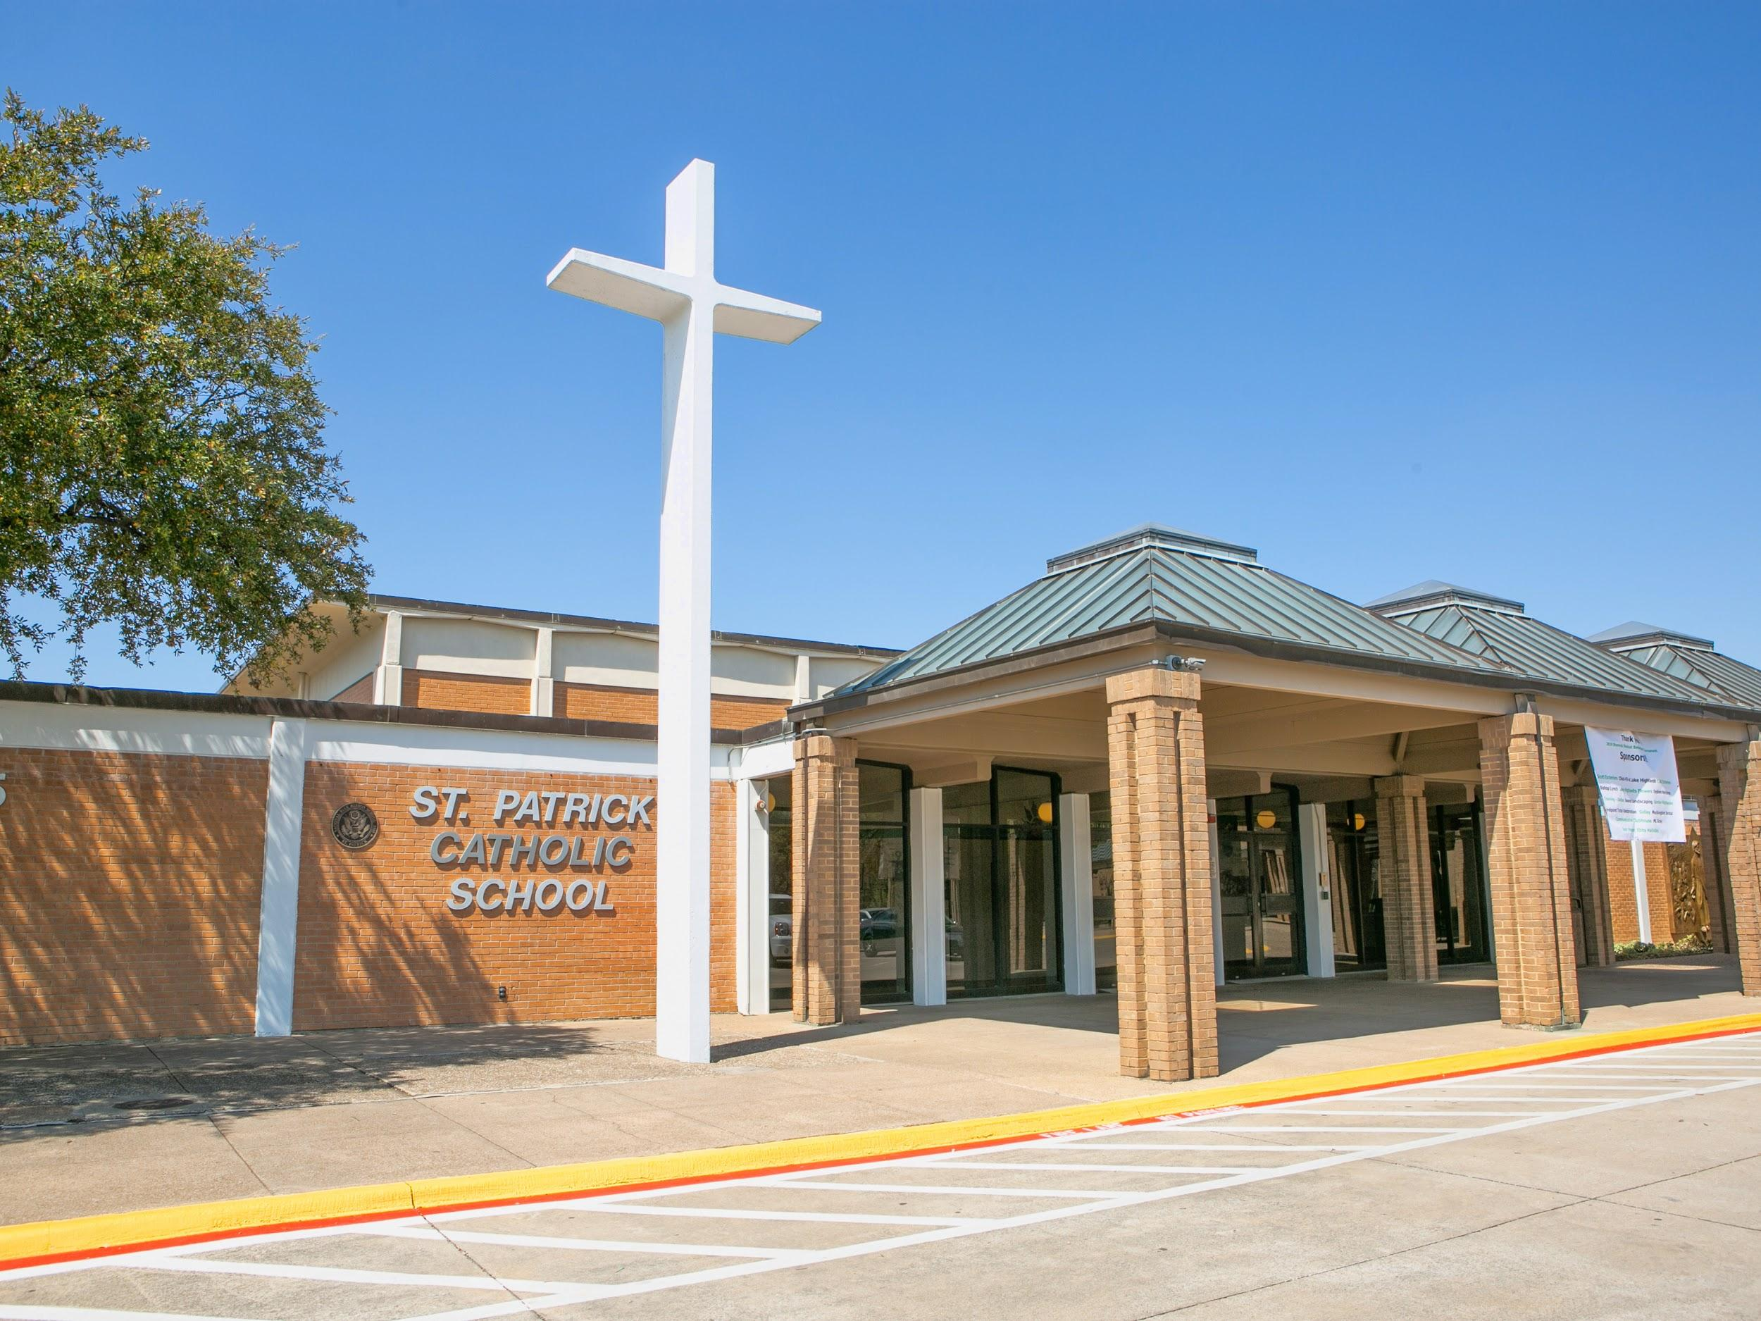
CURB APPEAL

Slide 11
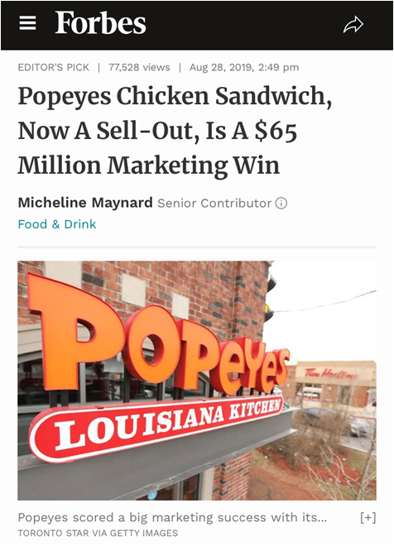
ONLINE PRESENCE
Why is the web so important?
Millennials are phone-averse
“telephone” apps on smartphones are only the fifth-most-used app
smartphone owners now spend over 2 hours a day using their phones
The “Anxious Generation”
Efficiency of internet information gathering
Accustomed to web-based interaction

Slide 12
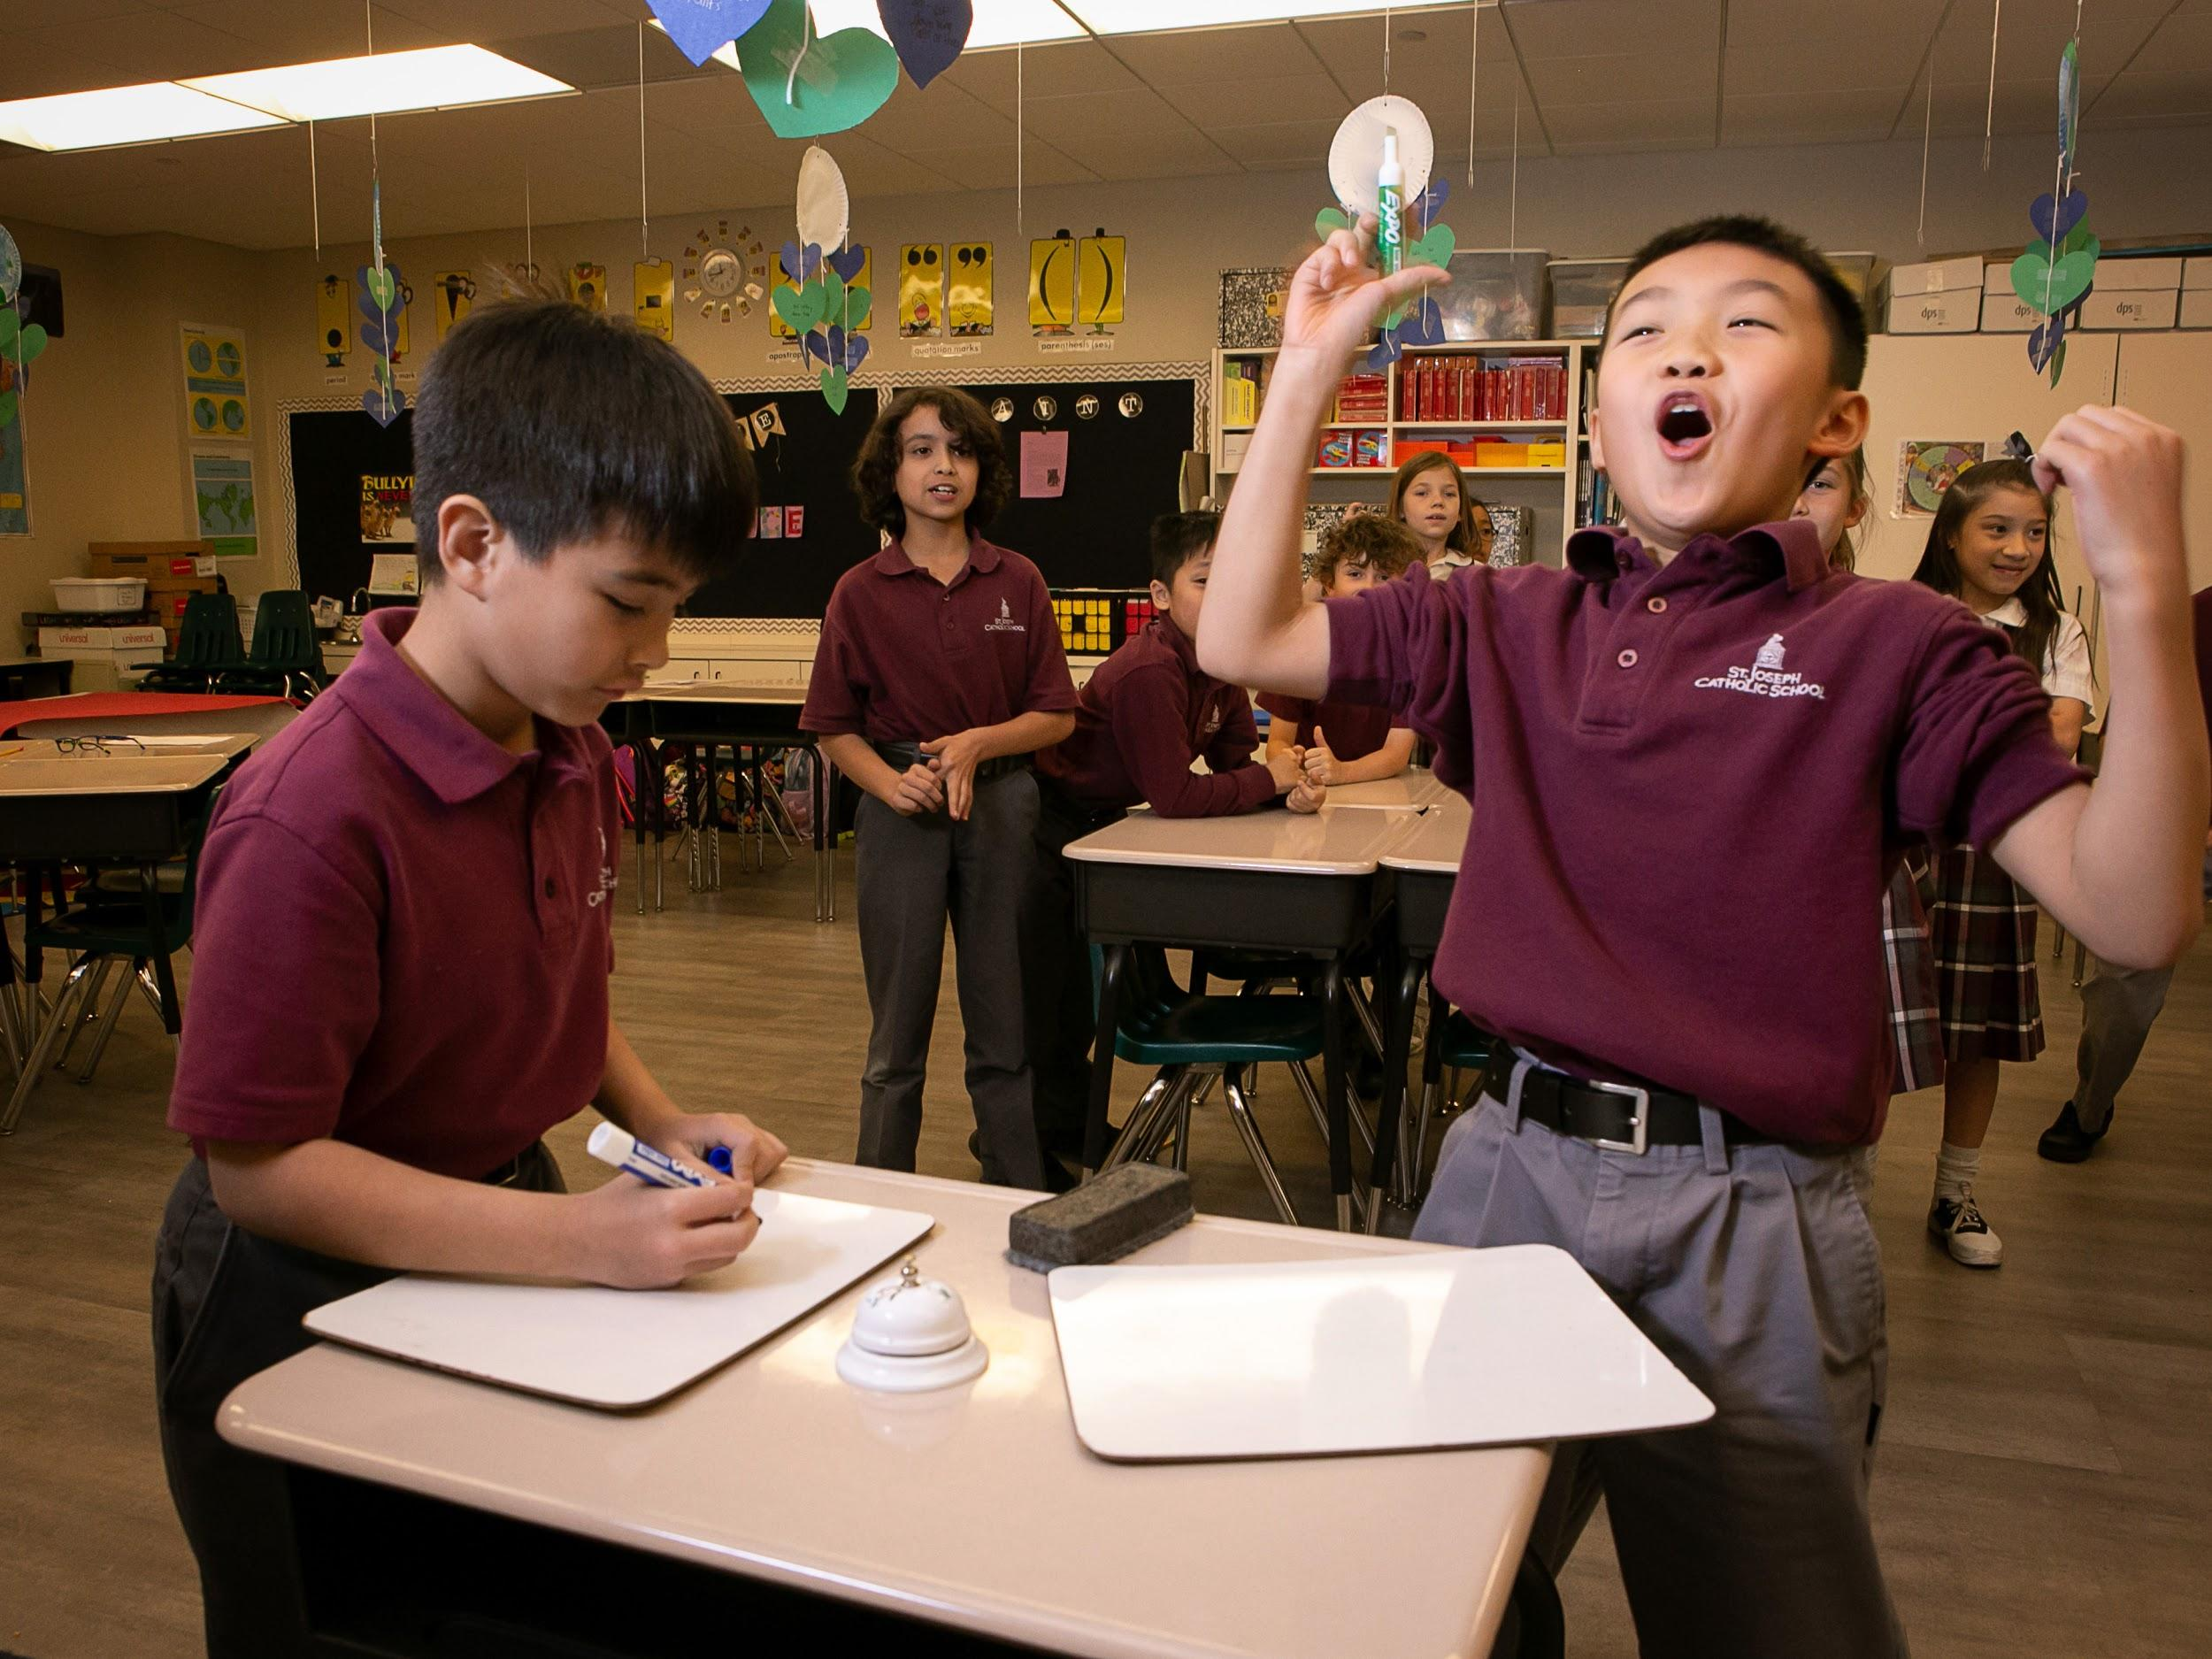
ONLINE: WEBSITE
Ease of access
Information capture
Mission focused
Accuracy of information
Aesthetically pleasing

Slide 13
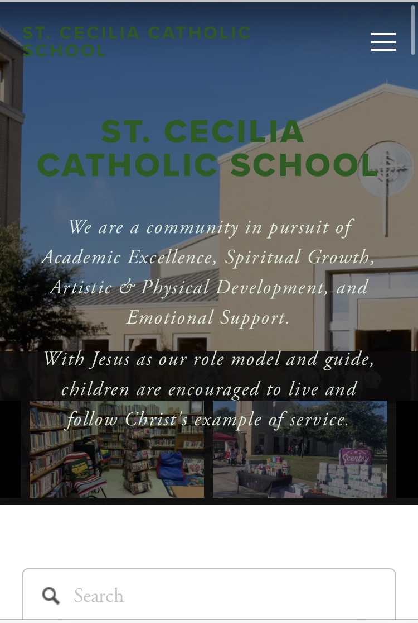

Slide 14
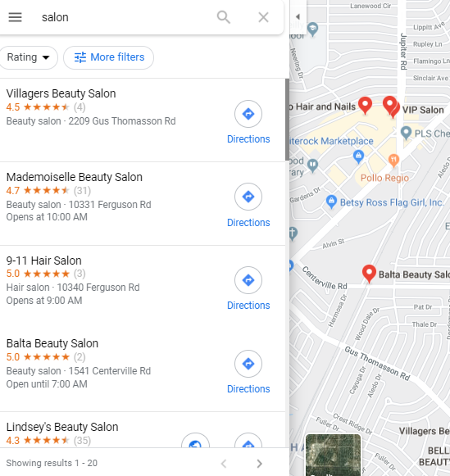
ONLINE: REVIEWS
Word of mouth historically most powerful marketing tool
People make their most important decisions via online reviews & photos

Slide 15
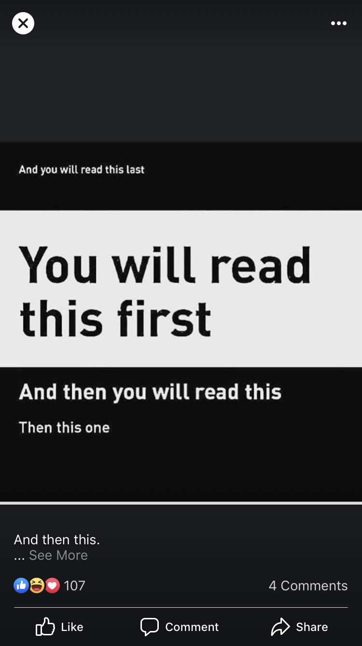
ONLINE: SOCIAL MEDIA
Not just what you post, but how
Algorithm updates
Generational usage
Platform use & engagement varies
Free marketing!
Develop a simple process
Tips for taking beautiful cell phone photos

Slide 16
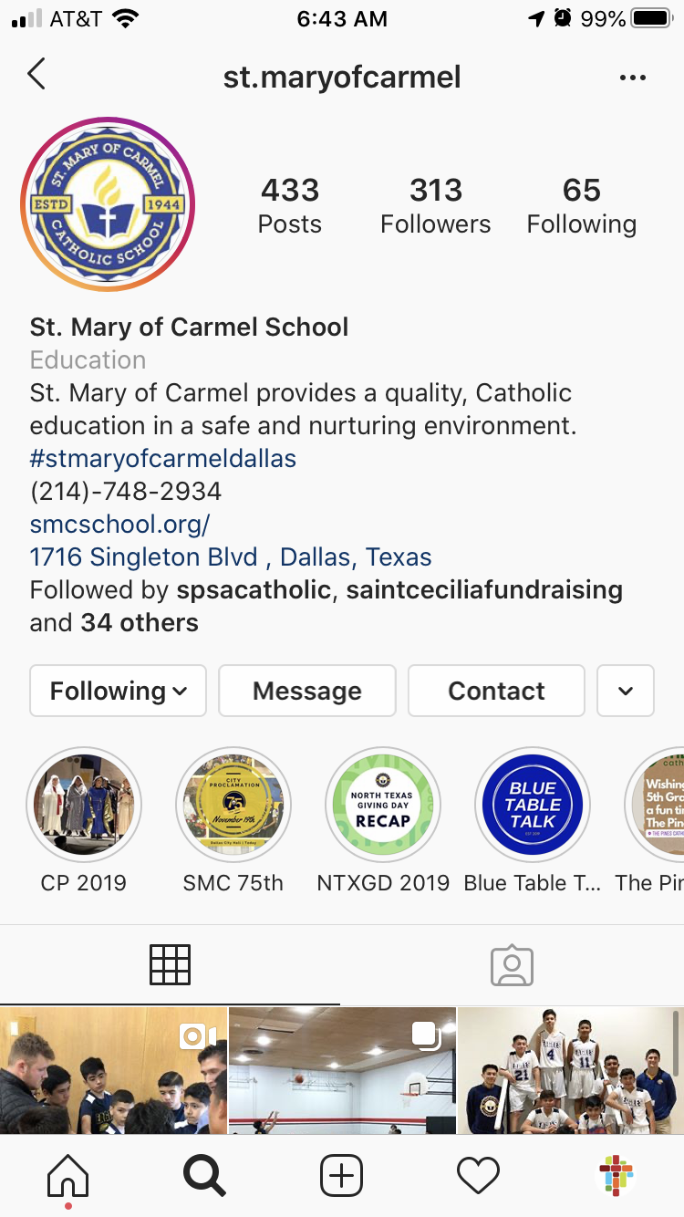
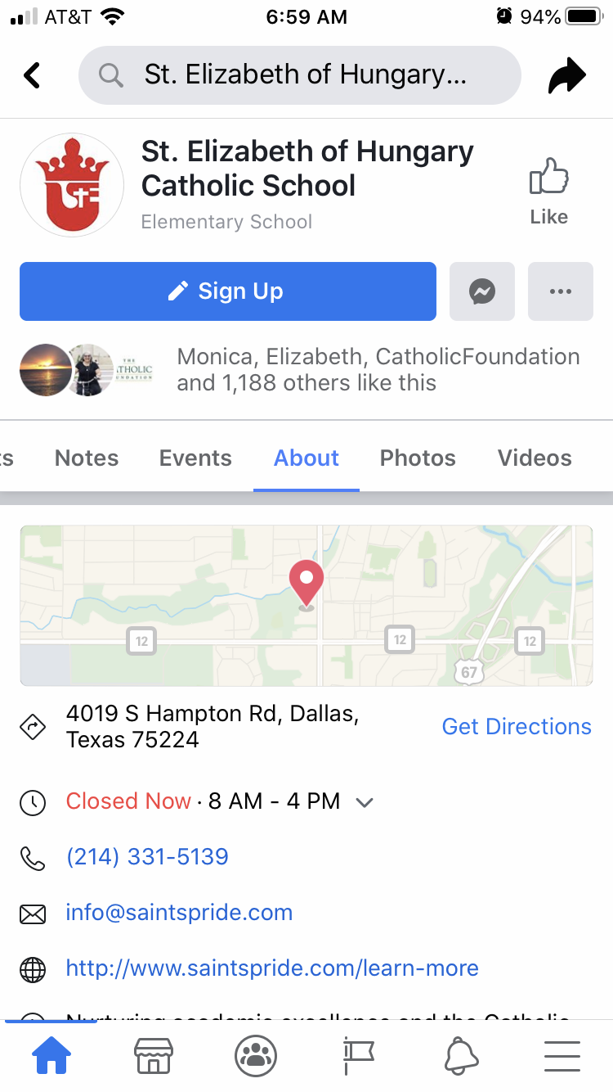
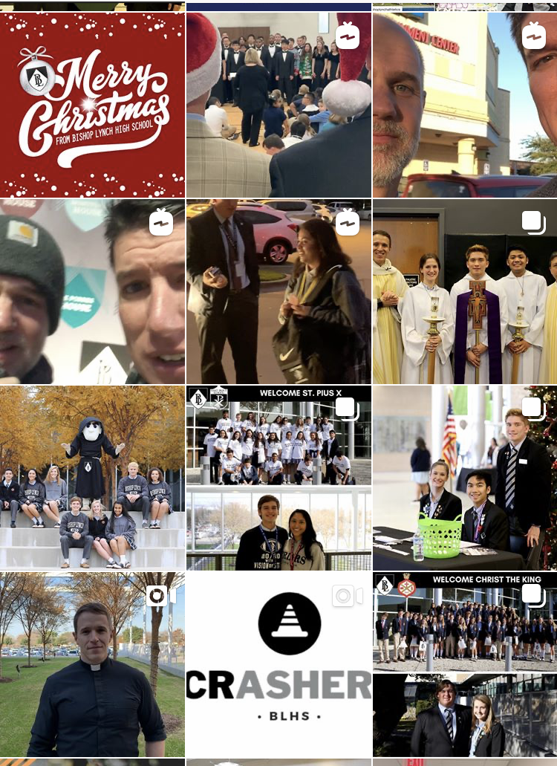

Slide 17
VISITING THE BUILDING
What do visitors experience when they walk in through the parking lot and into the front office?
If you were visiting for the first time, would you:
Know how to get to the front office? Know the hours of operation? Be greeted upon entering? Feel welcomed by the front office staff?
See evidence of the mission upon entering?

Slide 18
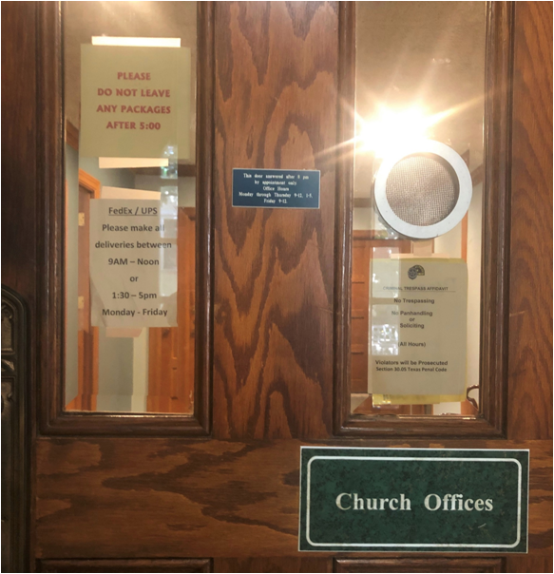
VISITING THE BUILDING
Signs at the main entrance welcome visitors
Office hours
How to enter the building
Front Office staff is welcoming & accommodating
Hospitality (coffee, water, comfortable seating) is offered
Front office is free of clutter
Visitor restroom is clean & stocked

Slide 19
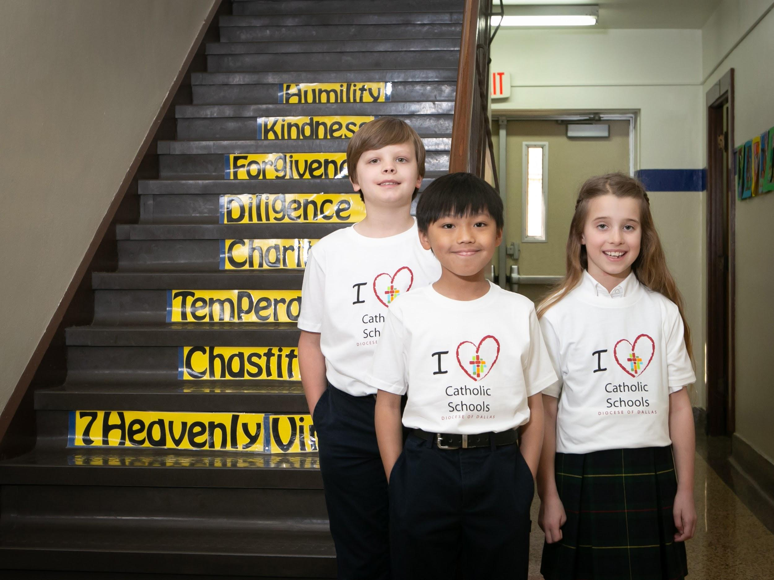
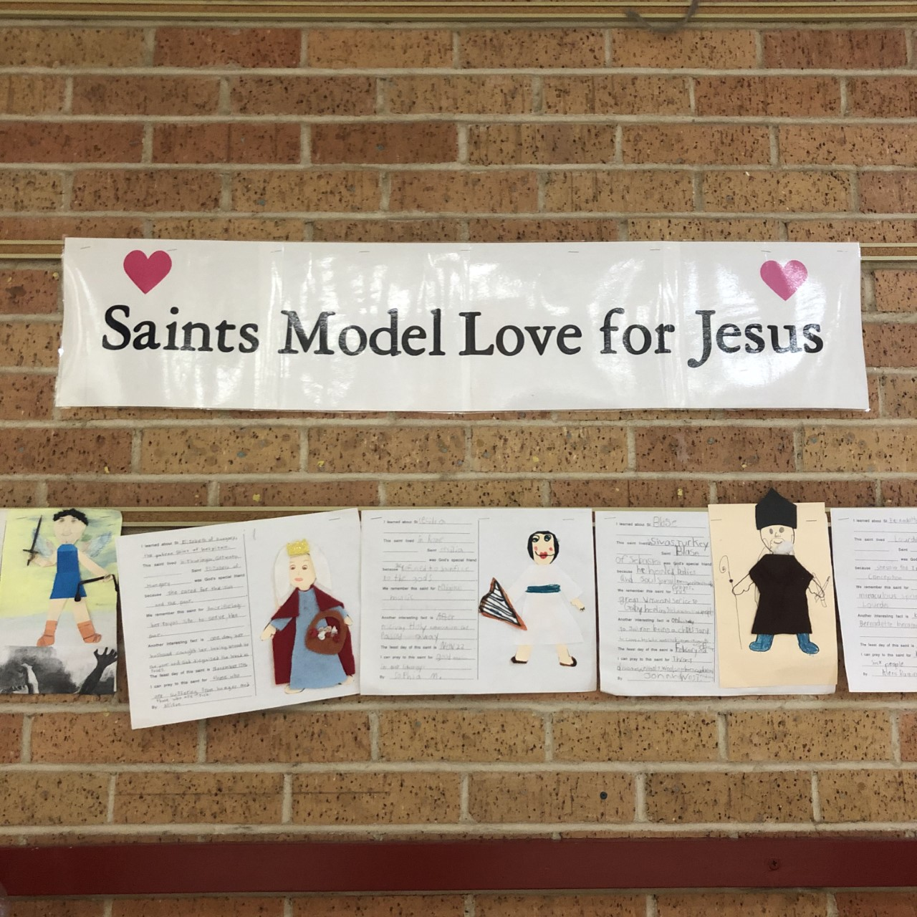
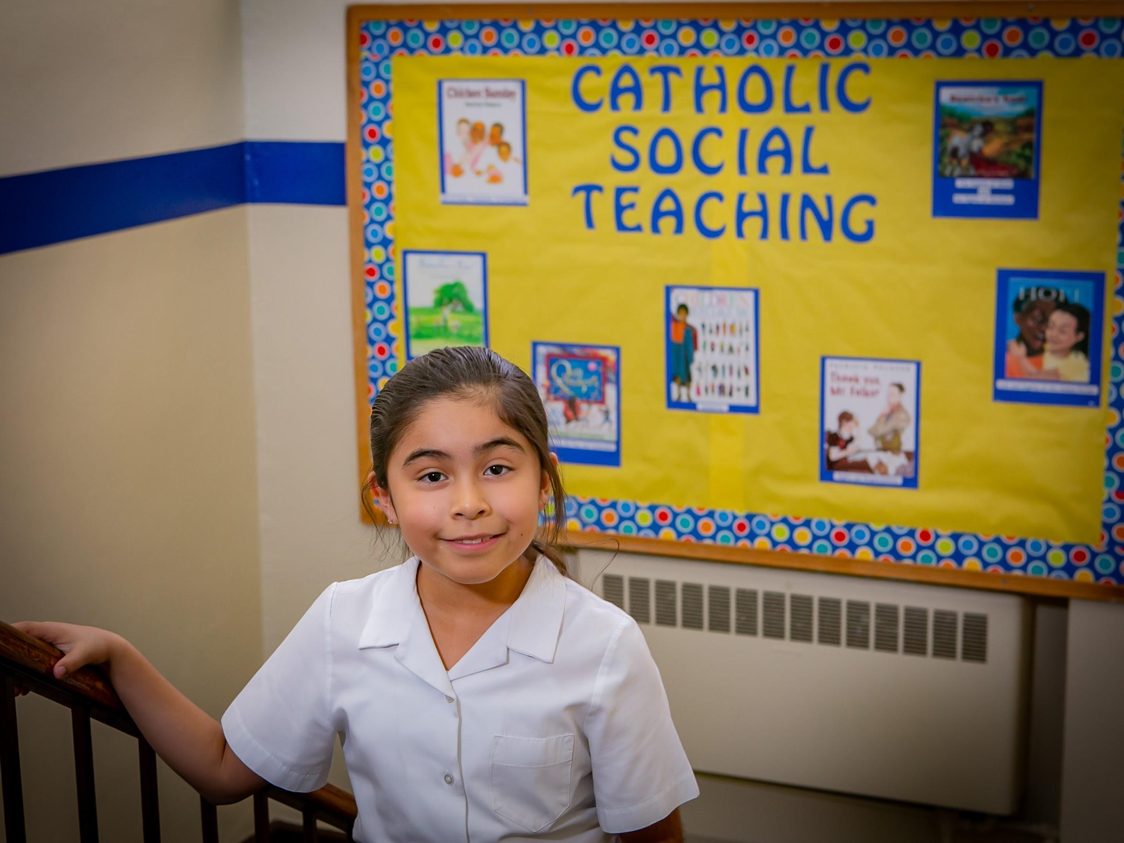
VISITING THE BUILDING
Mission posted
Relevant information available
Student artwork displayed
Clutter-free

Slide 20
THREE FIRST IMPRESSIONS:
High Effort/ Low Impact | High Effort/ High Impact
Low Effort/ Low Impact | Low Effort/ High Impact
Curb Appeal
Online Presence
Website
Reviews & Searches
Social Media
Inside the Building
Effort
Impact

Slide 21
Source Documents
First Impression Data:
https://www.psychologicalscience.org/observer/how-many-seconds-to-a-first-impression
Millennial First Impression Data:
https://www.modernhealthcare.com/article/20170107/MAGAZINE/301079983/provider-first-impressions-matter-most-for-millennials
Millennial Communication: https://www.forbes.com/sites/larryalton/2017/05/11/how-do-millennials-prefer-to-communicate/#148b3d5d6d6f

