Slide 1
Enrollment Management Workshop
Diocese of Dallas
Telling Your Story
Shana Rossi

Slide 2
Enrollment Management Workshop
Diocese of Dallas
“Why Brand Storytelling Should be
the Foundation of a Growth Strategy”
Steve Hemsley for www.marketingweek.com
From a very young age we love listening to stories and, as we grow older, we respond to tales and anecdotes.
Brands need to inject the magic of storytelling into their marketing to tap into people’s emotions.

Slide 3
Enrollment Management Workshop
Diocese of Dallas
The Science Behind Stories
When we are being told a story,
not only are the language processing parts in our brain activated,
but any other area in our brain that we would use
when experiencing the events of the story are too.
In other words…Stories put the whole brain to work.

Slide 4
Enrollment Management Workshop
Diocese of Dallas
Rising Strong
Brene Brown
We are wired for story…Neuroeconomist Paul Zak has found that hearing a story – a narrative with a beginning, middle, and end – causes our brains to release cortisol and oxytocin. These chemicals trigger the uniquely human abilities to connect, empathize, and make meaning. Story is literally in our DNA.

Slide 5
Enrollment Management Workshop
Diocese of Dallas

Slide 6
Enrollment Management Workshop
Diocese of Dallas
“Millennial Parents are Driving a Market Shift”
Aaron C. Cooper for NAIS
As the cost of independent school education continues to outpace inflation and new educational options abound, schools are struggling with branding their offerings in a way that resonates with today’s consumers. Independent school leaders have traditionally defined their schools through their missions and traditions. But today’s consumers want to be seduced by marketing, and parents are increasingly looking at independent school as a luxury product, making the “if we build and maintain it they will come” model unsustainable.
So what’s the best way for schools to demonstrate our value and tell our stories? By getting parents to do it for us.

Slide 7
Enrollment Management Workshop
Diocese of Dallas
“Millennial Parents are Driving a Market Shift”
Aaron C. Cooper for NAIS
They want their purchases to say something about them—what kind of people they are, what kinds of things they value, and what kinds of experiences they seek.
If schools want to get millennial families to take ownership of our stories and tell them as their own, we need to highlight attributes that authentically appeal to them and be eager to partner with them and take their suggestions seriously so that they are co-creating the environment in which they want to raise their children—and the brand with which they want to be associated.

Slide 8
Enrollment Management Workshop
Diocese of Dallas
“Millennial Parents are Driving a Market Shift”
Aaron C. Cooper for NAIS
Millennials have grown up with a wealth of information at their fingertips. For instance, when we promote small class sizes, they are Googling the relevant research (and perhaps finding class size doesn’t always matter quite as much as we suggest). An emphasis on “traditional values” may lead them to question how inclusive and innovative our schools are. While we as school leaders take comfort in the fact that our marketing matches our missions, we may be leaving out families who are looking for the latest pedagogy or a focus on extensive parent involvement. How would the millennial luxury buyer see themselves reflected in a brand that doesn’t seem to set itself apart as something as unique as their child?

Slide 9
Enrollment Management Workshop
Diocese of Dallas
“Millennial Parents are Driving a Market Shift”
Aaron C. Cooper for NAIS
Parents increasingly want a school that speaks well of the type of people that they are (and aspire to be) and that enhances their “personal brand.” A focus on marketing our core product of an excellent education isn’t enough and will not provide the emotional connection families need to effectively tell our school’s story in the same way they evangelize about a meal kit or workout routine on social media. Word-of-mouth publicity remains the single most important factor driving people to our schools, and parents-turned-evangelists are our salespeople whether they are across the coffee table or behind a screen.

Slide 10
Enrollment Management Workshop
Diocese of Dallas
“Jesus Told Stories to Make a Point”
Pastor Rick Warren for Pastors.com
Jesus was the master storyteller. He’d say, “Hey, did you hear the one about…” and then tell a parable to teach a truth.
In fact, the Bible shows that storytelling was Jesus’ favorite technique when speaking to the crowd: “Jesus spoke all these things to the crowd in parables; he did not say anything to them without using a parable.” (Matthew 13:34)

Slide 11
Enrollment Management Workshop
Diocese of Dallas
“Jesus Told Stories to Make a Point”
Pastor Rick Warren for Pastors.com
Stories hold our attention. The reason television became so popular is because it’s essentially a story-telling device, whether you’re watching comedy, drama, the news, or a talk show. Even the commercials are stories.
Stories stir our emotions. They impact us in ways that precepts and propositions never do. If you want to change lives, you must craft the message for impact, not for information.
Stories help us remember. Long after the outline is forgotten, people will remember the stories of the sermon.

Slide 12
Enrollment Management Workshop
Diocese of Dallas
Brains on Fire: Igniting Powerful,
Sustainable Word of Mouth Movements
Phillips, Cordell, Church, and Jones
Your company is the stories people tell about it.
Stories are real. Slogans are made up. Stories pull you in. Slogans try to push out a message. Stories are deep. Slogans are shallow. Stories are personal. Slogans are impersonal. Stories are passed on by word of mouth. Slogans are forced on us by ads.
Stories are part of who we are.

Slide 13
Enrollment Management Workshop
Diocese of Dallas
Robin Hood Marketing
Katya Andresen
“Messages should
establish a Connection, promise a Reward,
inspire an Action,
and stick in the Memory.
CRAM is the key to getting our distracted audience
attracted to our cause above all others.“

Slide 14
Enrollment Management Workshop
Diocese of Dallas
Ways to CRAM
One-way Communication
Traditional marketing outreach
Slogans and brochures
Two-way Communication
Interaction with “customers”
Elevator CONVERSATION
“Three-Way” Communication
Storytelling
Emotional connection

Slide 15
Enrollment Management Workshop
Diocese of Dallas
Facts
Attribute
Attribute
Stories
Emotion
Shared Experience

Slide 16
Enrollment Management Workshop
Diocese of Dallas
4 Benefits of Using Storytelling in Marketing
Steve Olenski
Convey Your Personality
Bring Your Brand In Front as the Lead
Hit the Emotional Quotient (EQ)
Keep Them Coming Back for More

Slide 17
Enrollment Management Workshop
Diocese of Dallas

Slide 18
Enrollment Management Workshop
Diocese of Dallas

Slide 19
Enrollment Management Workshop
Diocese of Dallas

Slide 20
Enrollment Management Workshop
Diocese of Dallas
Preach to the Choir so they will Sing Your Praises
Social Media, Blogs, Pod
Videos (student, parent, staff, professional)
State of the School Coffees
“Your School” Nights
Weekly E-newsletters
Add testimonials to EVERYTHING
Emails (go beyond the ordinary)

Slide 21
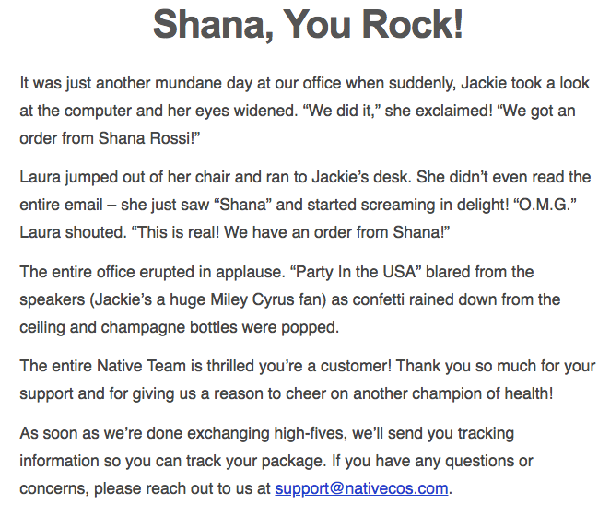
Enrollment Management Workshop
Diocese of Dallas

Slide 22
Enrollment Management Workshop
Diocese of Dallas
Your
Website

Slide 23
Enrollment Management Workshop
Diocese of Dallas
Mission
Key Attribute
Story
Story
Key Attribute
Story
Story

Slide 24
Enrollment Management Workshop
Diocese of Dallas

Slide 25
Enrollment Management Workshop
Diocese of Dallas
Shana Rossi
(302) 250 - 2119
srossi@partnersinmission.com

